Slide 1

FALCON HACKS CLUB · FOOTHILL HIGH SCHOOL
FALCON
HACKS ’26
Build something that takes flight.
INTRO MEETING · SEPTEMBER 21, 2026
Abhinav Garg, Founder · and the Falcon Hacks team
Notes:
Welcome everyone. Quick intros: who we are, what Falcon Hacks is, why you should care. About 15 minutes, then food and sign-in.

Slide 2



01 · THE BASICS
What’s a hackathon?
01
An app
Something people can actually use.
One day. You and a team pick an idea and build it. An app, a game, a hardware project, anything. At the end, you demo it to the room.
02
A game or tool
Fun, weird, or useful. Your call.
03
Hardware
No lectures. No homework. Just building.
Sensors, robots, physical things.
FALCON HACKS ’26
falconhacks2026.com
Notes:
Kill the fear early. It's not a test, it's a build day. Give one concrete example of a project a first-timer could make.

Slide 3
02 · THE EVENT
Falcon Hacks, in four words.
ONE DAY
FREE
Show up in the morning, demo by night.
No cost to attend. Ever.
OPEN TO ALL
NO EXPERIENCE NEEDED
Any age. Any school. Any skill level.
First-timers are the whole point.
FALCON HACKS ’26
falconhacks2026.com
Notes:
Four things to remember. Hit 'no experience needed' hardest. That is the biggest reason people don't show up.

Slide 4
03 · MARK IT
OCT 24
SATURDAY · 2026
Bay Area. Venue announced soon.
FALCON HACKS ’26
falconhacks2026.com
Notes:
Let this one sit. Say the date out loud twice. Tell them to put it in their phone right now.

Slide 5
04 · PRIZES
$3,500
Multiple categories
Not just one winner. Different tracks, different prizes.
Plus internships
Top teams get placement shots with our sponsors.
IN PRIZES
STILL GROWING
FALCON HACKS ’26
falconhacks2026.com
Notes:
Say the number. Don't break down the tiers yet. Mention internships for top teams.

Slide 6
05 · SPONSORS
Announcing soon.
Big names are locked in. Full reveal at the next meeting.
01
02
03
04
SPONSOR
SPONSOR
SPONSOR
SPONSOR
REVEAL SOON
REVEAL SOON
REVEAL SOON
REVEAL SOON
FALCON HACKS ’26
falconhacks2026.com
Notes:
Tease it. Names are locked, reveal comes at the next meeting. Gives them a reason to come back.

Slide 7



06 · WHY SHOW UP
What’s in it for you
Real hackathon experience
A finished project, a live demo, and something real to put on college apps.
Leadership next year
Most of us are seniors. Every leadership role opens up next year.
People who build
Mentors, sponsors, students from other schools. People you won’t meet in class.
FALCON HACKS ’26
falconhacks2026.com
Notes:
This is the recruiting slide. Be honest: we're seniors, we're gone in June, and someone in this room runs this next year.

Slide 8
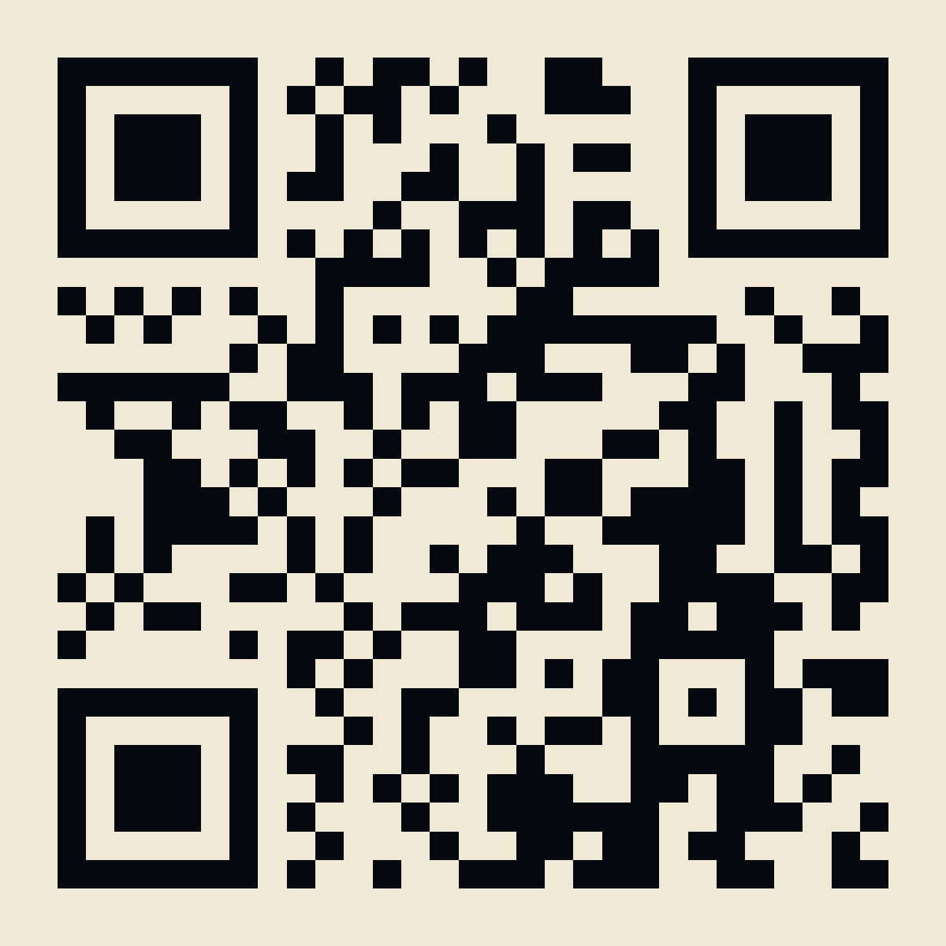
07 · GET INVOLVED
Start now, not in October.
01
Join the Discord
Announcements, planning, and everything in between.
02
Come to planning meetings
Weekly. Same room. Bring ideas.
03
Pick a role
Outreach · Design · Logistics · Sponsors
JOIN THE DISCORD
discord.gg/RTDMwuKAEB
FALCON HACKS ’26
falconhacks2026.com
Notes:
Give them a path from sitting here to being on the team. Discord first, everything else flows from there.

Slide 9
BEFORE YOU LEAVE
Sign in before you leave.
ATTENDANCE
FORM QR
Scan to add yourself to the attendance sheet. Takes ten seconds.
Questions? Come talk to us after.
falconhacks2026.com
SCAN · SIGN IN
FALCON HACKS ’26
falconhacks2026.com
Notes:
Nobody leaves without scanning. This is the attendance sheet for meeting minutes. Then food.

